Slide 1

Data-flow Analysis
Credit One

Slide 2
Contents
Goal
Data science process framework
Descriptions and location of related data sources
Manage the data for the project
Known issues with the data
Flowchart visualizing the detailed process
Initial insights of the data

Slide 3
Goal
Over the past year or so Credit One has seen an increase in the number of customers who have defaulted on loans they have secured from various partners, and Credit One, as their credit scoring service, could risk losing business if the problem is not solved right away.
The objective of our Data Science team is to design and implement a creative, empirical solution that assist Credit One improve their credit scoring service.
Primary Goal is to reduce the number of customers that defaulted on loans by at least 10%, creating and implementing a model that predicts which loan applicants are likely to default.

Slide 4
Data science process frameWORK
Framework - Zumel and Mount
Notes:
Consider talking about:
Convergence
The work list approach
The order matters
Initialization

Slide 5
Framework - Zumel and Mount
I am proposing to follow Zumel and Mount Framework because it separate the data science process within 6 important stages that guides us through the whole process step by step.
It is important to keep in mind that the boundaries between the stages are fluid, and the activities of one stage will often overlap those of other stages. And always we will go back and forth before moving into a new stage.
Other important reason Zumel and Mount was selected is because at the end of one project may lead into a follow-up project and since we already have the stages defined the whole process becomes more practical.

Slide 6
Framework - Zumel and Mount
Define
Define the Goal
Primary Goal is to reduce the number of customers that defaulted on loans by at least 10%, creating and implementing a model that predicts which loan applicants are likely to default.
Collect and Manage
Collect and Manage Data
General, History of las Payment, Amount of bill statement, Amount of previous payment, clients behaivour.
Credit score, income typo of loan, Credit score, APR, Available credit, Credit utilization, collections are not included in the dataset..
Build
Build the Model
Training set of 75% and Test set 25%
Classification model will be evaluated: C5.0, Random Forest, SVM, kkn, Decision trees.
Evaluate and Critique
Evaluate and Critique Model
Evaluation of the model. Is the goal meet?
Is the model accurate enough to meet the stakeholders’ needs?
Does it perform better than “the obvious guess” and any techniques being used currently?
Do the results of the model make sense in the context of the real-world problem domain?
Present
Present Results and Document
How should stakeholders interpret the model?
How confident should they be in its predictions?
When should they potentially overrule the model’s predictions?
Deploy
Deploy Model
How is the model to be handed off to “production”?
How often, and under which circumstances, should the model be revised?

Slide 7
Descriptions and location of related data sources
General
Gender
Education
Marital Status
Age
History of last Payment
Amount of Bill Statement
Amount of previous payment
April to September
April to September
April to September
Client’s Behaviour
Default
No default
Amount of the Given Credit
Notes:
Consider talking about:
Forward Analysis
Backward Analysis

Slide 8
Is the data quality good enough?
Type of Loan
Credit Score
APR
Available credit
Credit Utilization
Number of Collections
Some additional factors that will help us determine if a loan should be granted

Slide 9
Manage the data for the project
Compliant with Data Privacy Regulation: Personal data privacy and protection is our priority in this organization.
Cleaning the Data: The task of cleaning the data includes the removal of redundant, missing words, duplication, and redundant data.

Slide 10
Known issues with the data
No missing data
PAY_0 needs be renamed to PAY_1
“default payment next month” needs to be renamed
Double headers in the file, we can get rid of X1 …. X23 and Y
ID is not relevant.
We can create a group for age and
Additional questions:
Why when the payment was paid in full, we have Default data under history of last payments?
Notes:
Consider talking about:
Bit vector problems
IFDS problems

Slide 11
data science Flowchart visualizing the detailed process

Slide 12
Start
Wrangling, exploration and cleaning
Feature Engineering
No
Deploy Model
Does the model satisfy requirement
Business understanding
Visualizing and find insights
Parameter Tuning
Monitor, analyze, manage
Yes
Unit Test and refactoring
Define Goal
Produce a preliminary report of data
Model Training
Was the goal achieve or change?
No
Present results and document.
List necessary questions or points of interest
Test the model
Yes
Feedback and reporting
Maintain
Performance measure

Slide 13

Initial insights of the data

Slide 14
Correlation

Slide 15
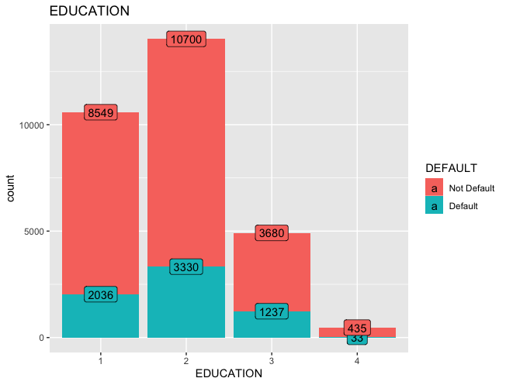
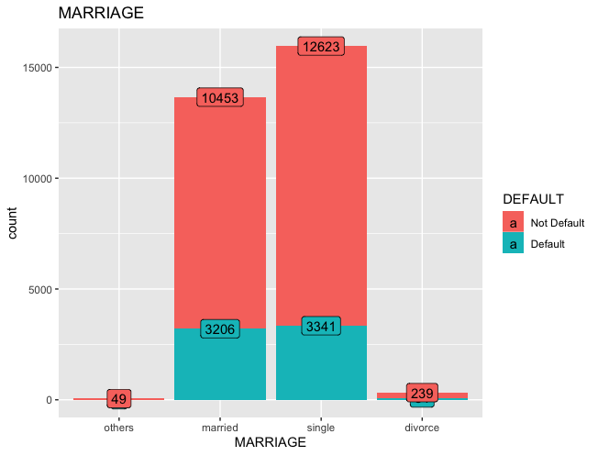
INSIGHTS OF THE DATA
Education
University group as the higher default count
Marital Status
Marriage and single marital status has almost the same default count

Slide 16
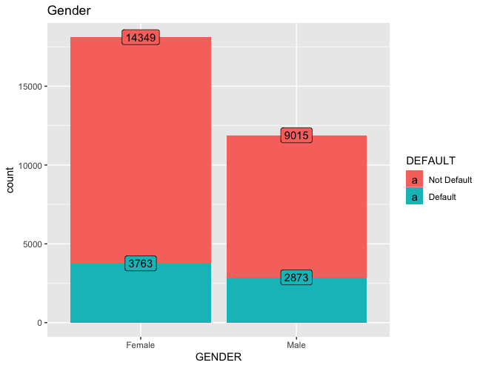
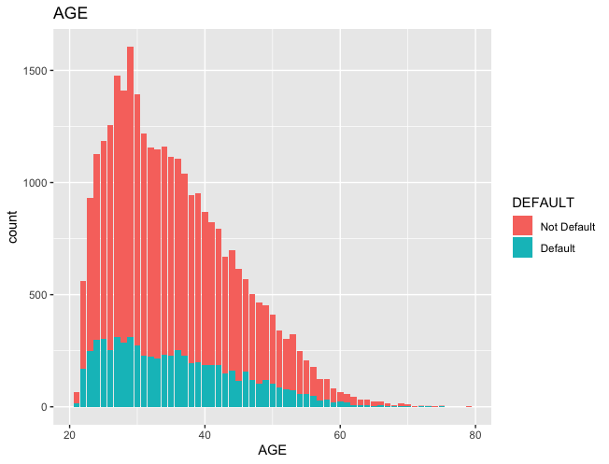
INSIGHTS OF THE DATA
Gender
Females has a higher default count
Females has a higher not default count
In general, there are more loans for females
Age
Default count is higher for the group less than 30 years old.
Default count decreases as age increases

Slide 17
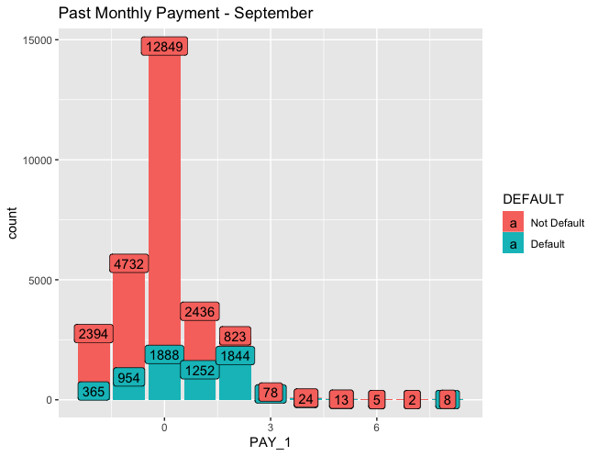
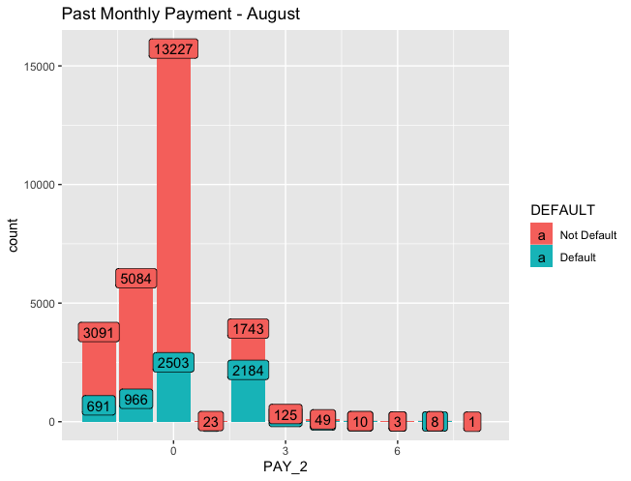
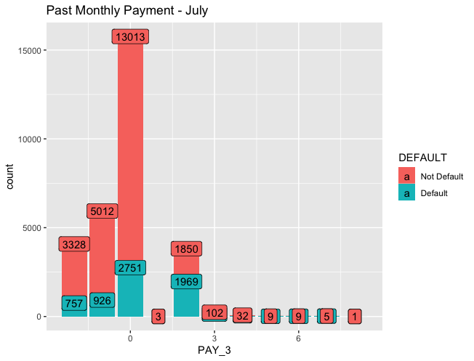
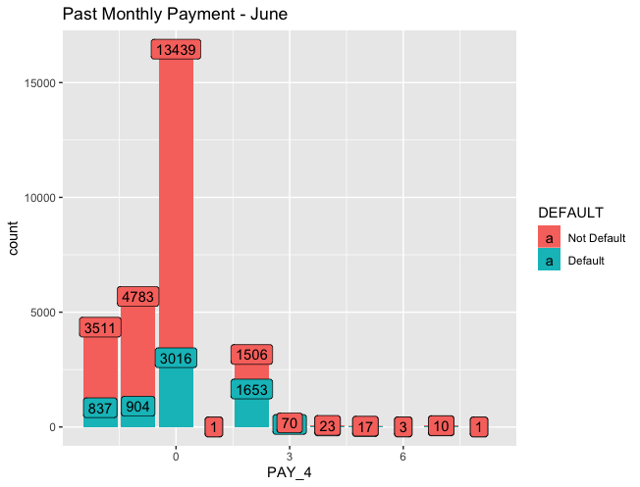
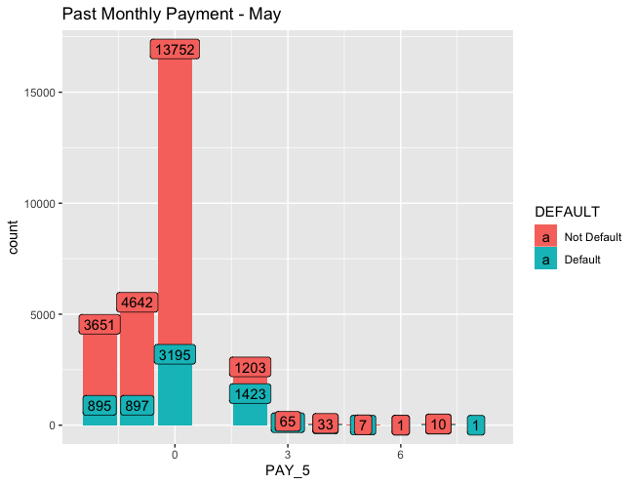
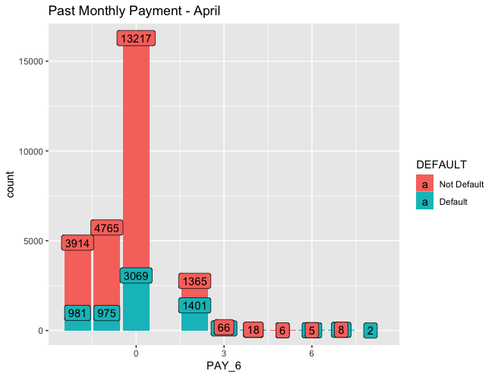

Slide 18

INSIGHTS OF THE DATA
-2 =No consumption;
-1= Paid in full;
0 = The use of revolving credit;
1 = payment delay for one month;
2 = payment delay for two months;
8 = payment delay for eight months;
Questions
Why if the payment was paid in full, we have Default data?
Insights
Payment delay for one month is higher in September
Payment delay for two months is higher in July
Payment delay for more than two months is in average less than 100

Slide 19
Questions

